Slide 1
Capstone Project Presentation
(Internship)
MENTOR: ARYAN AGARWAL
COMPANY: GLUE LABS
NAME: SHREYA MAHESHWARI
E. NO: E18CSE170

Slide 2


ABOUT GLUE LABS
Glue Labs is a 10-year-old startup with an all-remote team.
The team at Glue Labs consists of senior developers and managers who have been there from the start and built everything from the scratch. The culture here at Glue Labs is based on innovations and exploration. There are multiple technologies we are using in Glue Labs and each and every member of our team is well aware of different cutting edge technologies.
Our latest product is FIFO, which is a social media platform where people from different communities grow, learn and have meaningful conversations together.

Slide 3
GLUE LABS’ EDGE
Technology Edge
Fast time to market
Product Evolution

Slide 4

About FIFO
FIFO is a peer-to-peer discussion platform which makes it easy for people from different communities to come together and have discussions about anything and everything under the sun.
This platform is especially for creators and makers to interact with their audiences- share their views and get to know their side as well.

Slide 5
My Team
Mentor: Aryan Agarwal
Team: Product Development Team
Project: FIFO

Slide 6
My Journey
I was hired as a Software Engineer Intern at Glue Labs.
I was trained to become a Full Stack Developer in technologies such as Reactjs, PostgreSQL, etc.
Currently, I am a part of the FIFO product development team where my responsibilities include design and development of FIFO platform.

Slide 7







TECHNOLOGIES USED
Reactjs
Redux
Redux-Saga
Node js
GraphQL
PostgreSQL

Slide 8
Learning Outcomes
Power Learning
Communication Skills
Team work
Best Practices
Innovation
Learnt about new and upcoming web development technologies.
Improvement in communication skills
Learnt about work culture in a team and how to meet deadlines.
UI and UX Best Practices and about how to write clean, compact, reusable and efficient code.
Startups promote innovation which has helped my creative mind grow tremendously

Slide 9
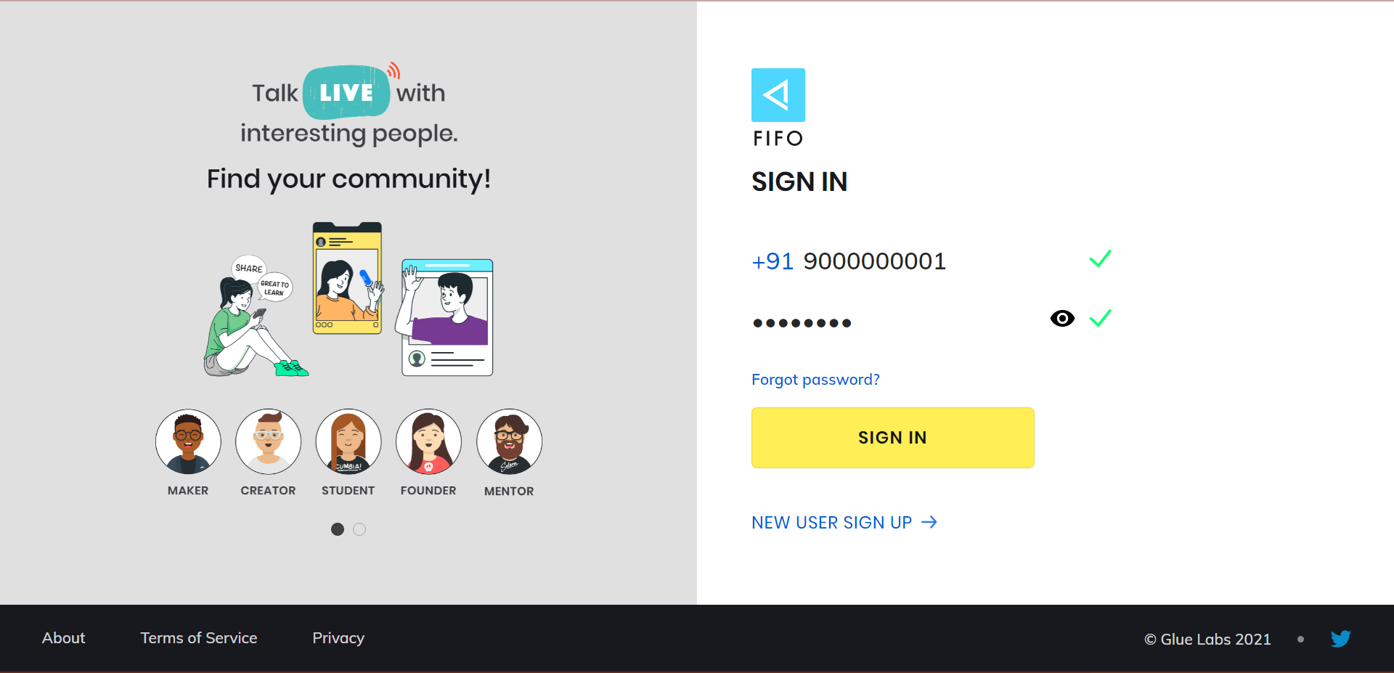
FIFO Website

Slide 10
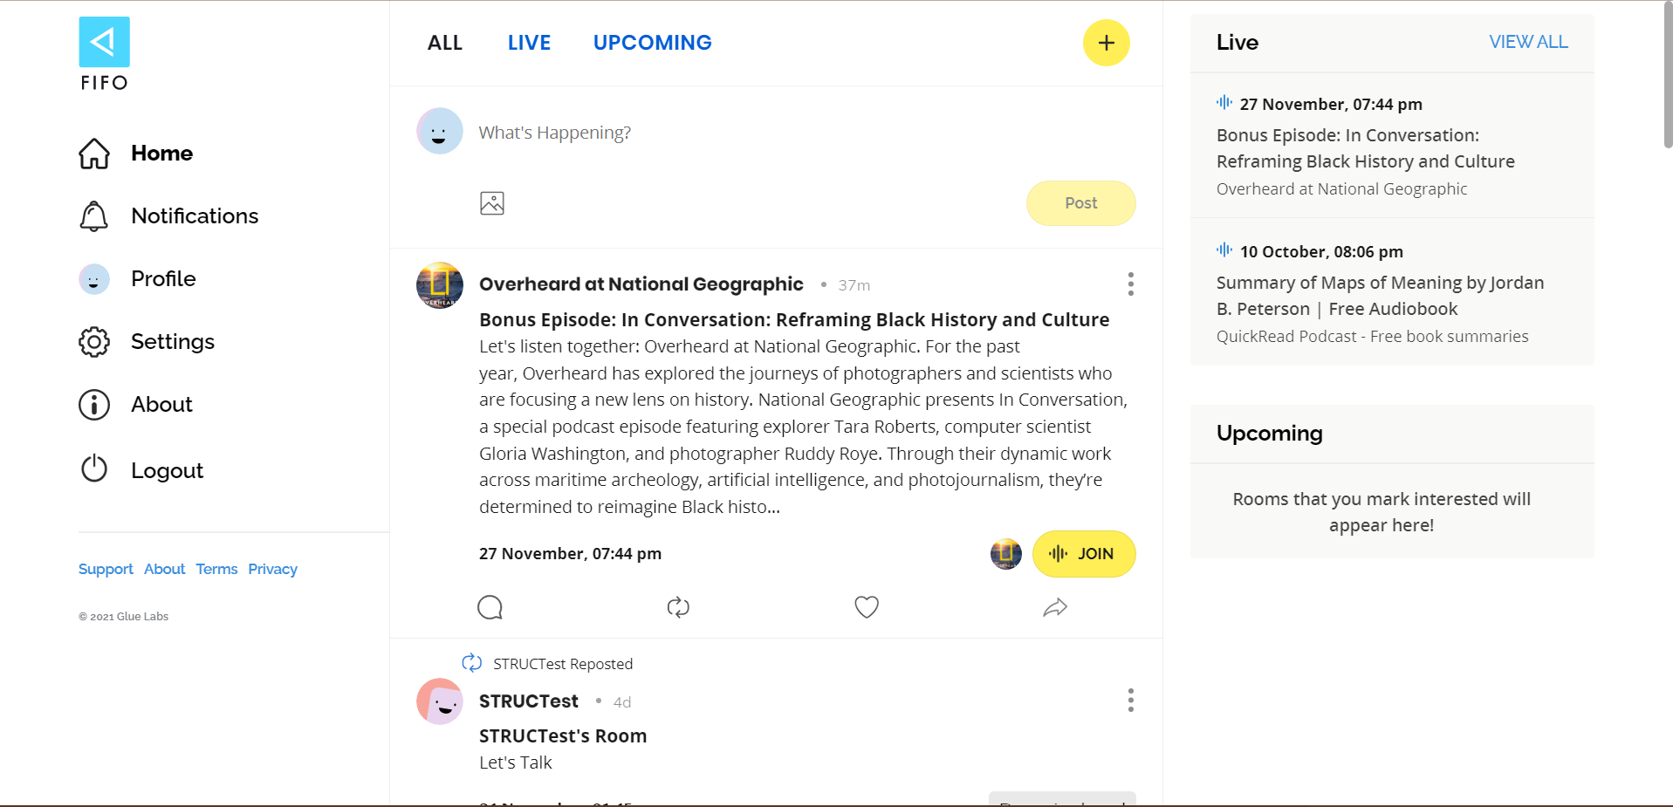

Slide 11
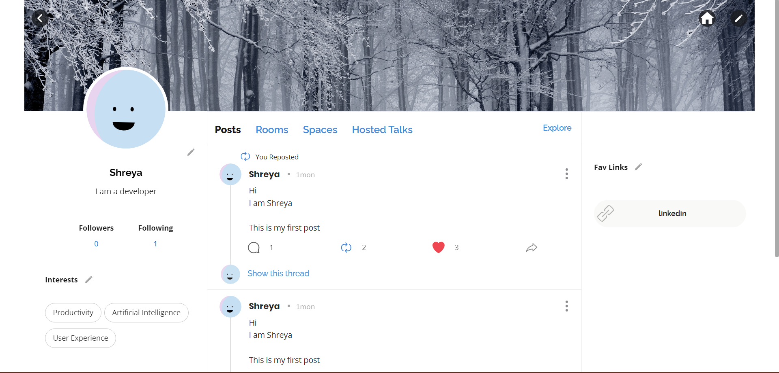

Slide 12
References
Glue Labs Website: https://www.gluelabs.com/
FIFO Website: https://fifo.im/
Blog Link: https://medium.com/@shreya.maheshwari.2000/react-ing-my-way-into-web-development-fe0bebd5cc46

Slide 13
Thankyou
NAME: SHREYA MAHESHWARI
E. NO: E18CSE170

